Slide 1






Starbucks Sales Analysis
Presented by
Anas Riyaz Chawoos

Slide 2
Introduction
This project conducts a detailed sales analysis of Starbucks, employing MySQL as the foundational tool for data management and querying. The core objective is to extract actionable insights from a comprehensive sales dataset, enabling a deeper understanding of customer behavior and market dynamics. Through meticulous data cleaning and preprocessing, followed by targeted SQL queries, we will identify key sales trends, product performance, and the impact of various factors on revenue. This data-driven investigation aims to provide Starbucks with quantifiable intelligence to optimize its strategies, enhance operational efficiency, and drive continued success in the competitive global beverage industry.

Slide 3
History of Starbucks
Starbucks began its journey in 1971 in Seattle's historic Pike Place Market, founded by Jerry Baldwin, Zev Siegl, and Gordon Bowker. Initially, it sold high-quality whole bean coffee, tea, and spices, inspired by the Dutch coffee entrepreneur Alfred Peet. The name "Starbucks" was drawn from the first mate in Herman Melville's Moby-Dick, evoking the romance of early coffee traders. The pivotal shift from a bean retailer to the globally recognized coffeehouse chain occurred in the 1980s, largely due to Howard Schultz. After being captivated by the vibrant espresso bar culture during a trip to Milan, Schultz envisioned Starbucks as a "third place" – a welcoming space between home and work. Despite initial resistance from the founders, Schultz eventually acquired Starbucks in 1987, rapidly expanding its presence and transforming it into the coffee giant known worldwide today, synonymous with a premium coffee experience and community gathering.

Slide 4

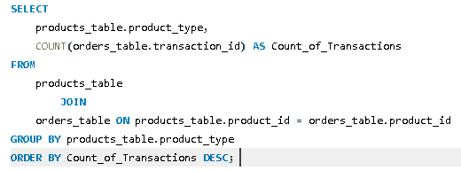


What is the total number of transactions for each product?

Slide 5
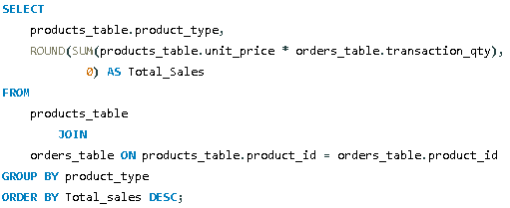

List product names and their total sales quantity.

Slide 6
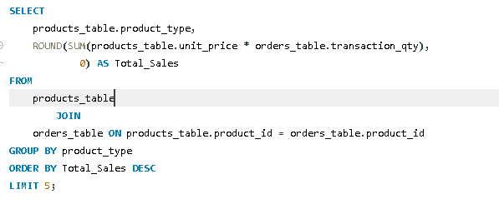
Find the top 5 products by revenue.

Slide 7
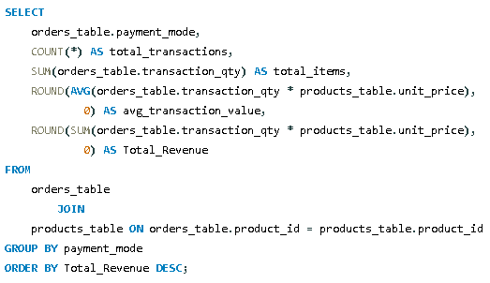

Calculate total revenue for each payment method

Slide 8
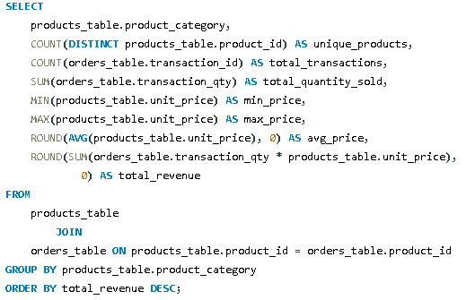

Get Sales Statistics for each Category

Slide 9

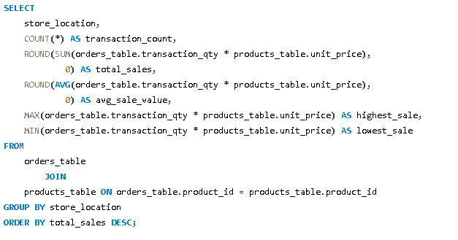
Analyze performance metrics by store location

Slide 10
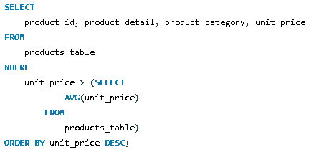
Find products with unit price above the average price

Slide 11
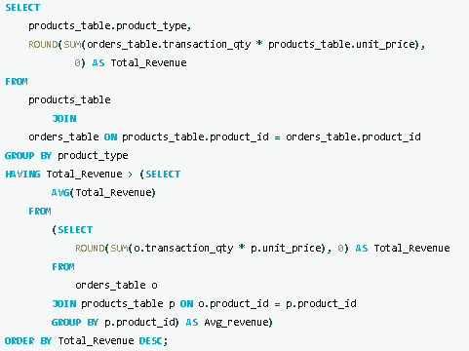
Find products that have generated revenue above the average product revenue

Slide 12
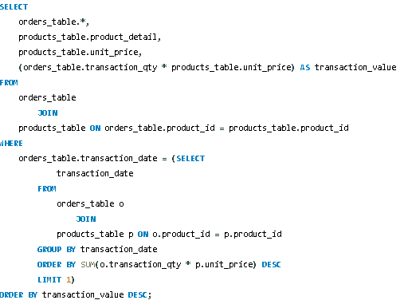
Find all transactions from the day with highest total sales

Slide 13
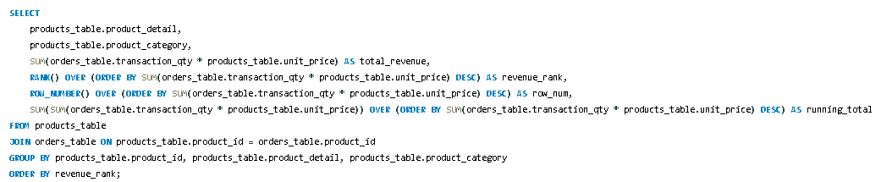
Rank products by their total revenue with running totals

Slide 14
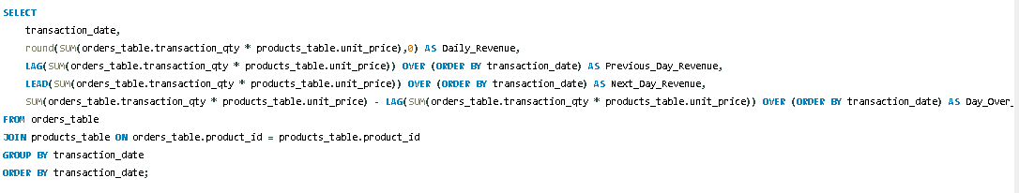
Analyze daily sales patterns to identify growth or decline trends

Slide 15
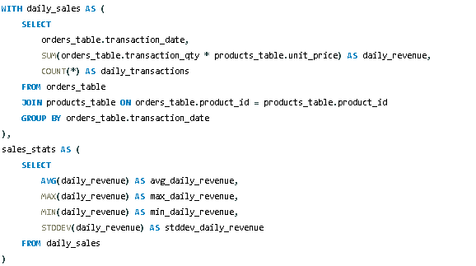
Analyze daily sales performance and categorize each day as high, average, or low performing compared to overall statistics part 1.

Slide 16
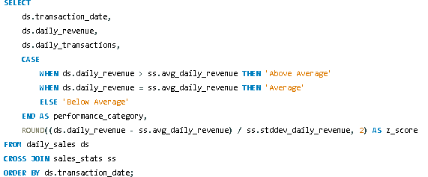
Analyze daily sales performance and categorize each day as high, average, or low performing compared to overall statistics part 2.

Slide 17
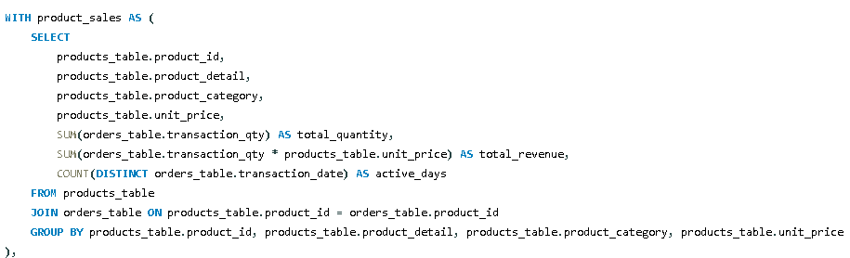
Show comprehensive product analysis including sales volume, revenue, category share, and performance classification part 1.

Slide 18
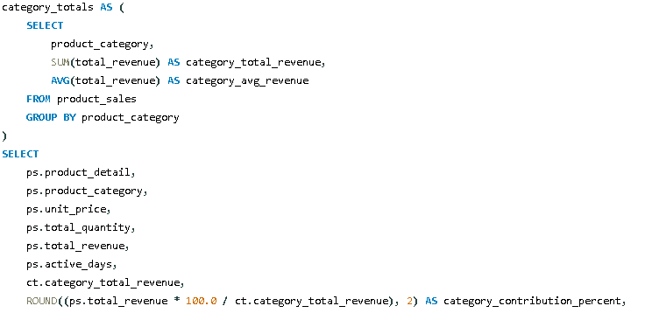
Show comprehensive product analysis including sales volume, revenue, category share, and performance classification part 2.

Slide 19
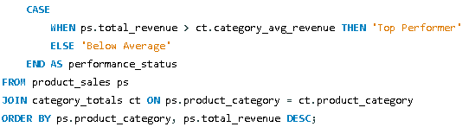
Show comprehensive product analysis including sales volume, revenue, category share, and performance classification part 3.

Slide 20
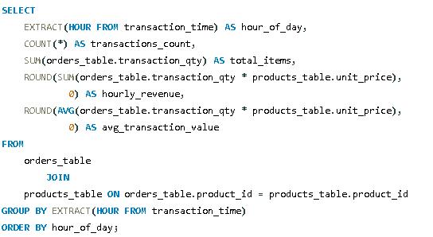
Which hours of the day generate the highest sales volume and revenue.

Slide 21
THANK YOU

